Slide 1
The sentiment and need analysis of type 1 and type 2 diabetes
Group 4

Slide 2
Team members
CHAN Kiu Nga, Sandy (56219011)
CHAN Tsz Ngai, Matthew (56213172)
Ma Wing Kin, Paul (56243594)
NG Sin Yung, Cindy (56213971)

Slide 3
Table of contents
01
02
03
04
Introduction& Data extraction
Data processing
Methods & results
Conclusion

Slide 4
01
Introduction & Data extraction

Slide 5
The type of diabetes
Type 1
Cause by an autoimmune reaction. This destroys the cells in the pancreas that make insulin .
Type 1.5 (LADA)
Between from diabetes type 1 and diabetes type 2
Type 2
Cause by pancreas does not produce enough insulin.
Most common diabetes type
But what are the needs and sentiment of these diabetes patients?

Slide 6
Diabetes forum
To understand the needs and sentiments , we extracted information from the 2 diabetes forums
Because they are…
✓ Can be extracted without permissions
✓ Divided the discussions into group for 3 diabetes types -> fair comparison for each diabetes’ type popularuty in the forums
Websites | Type 1 forum | Type 1.5 forum | Type 2 forum
Diabetes Daily Forum | ✓ | ✓ | ✓
Diabetes.co.uk | ✓ | ✓ | ✓

Slide 7
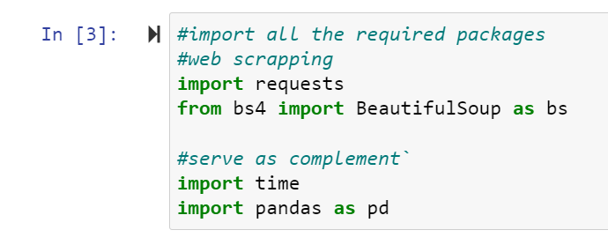
Extraction method
1. Import required package

Slide 8
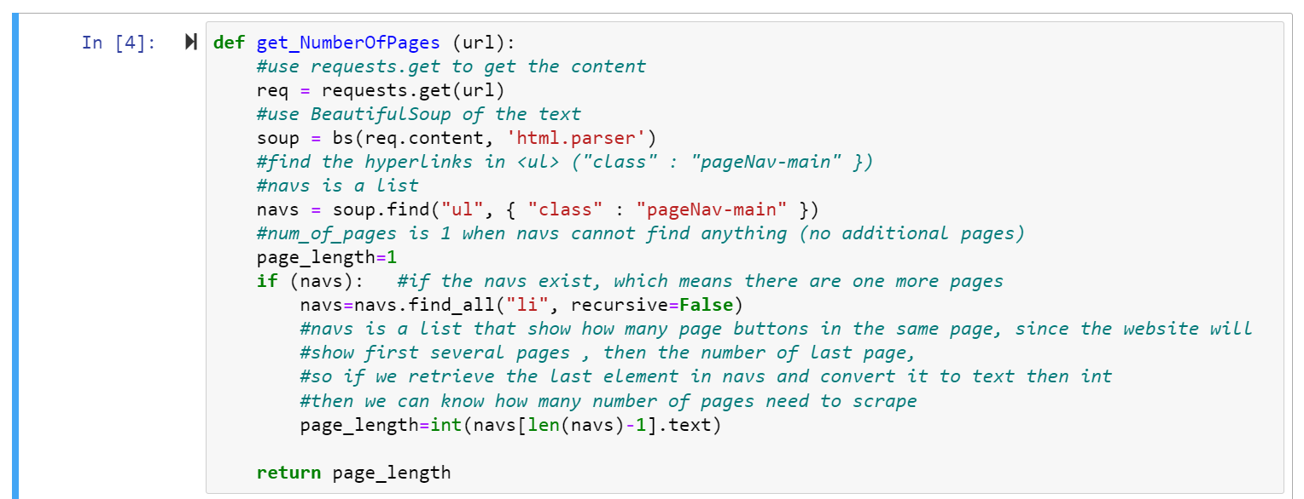
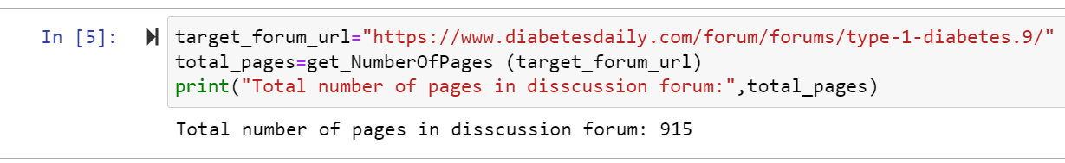
Extraction method
2. Define the function for extracting the
maximum possible number of pages
in a fourm's / discussion topic

Slide 9
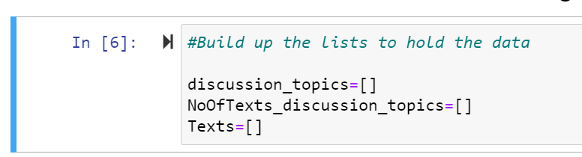
Extraction method
3. A user defined function
for extracting the data
(plug the page number to the function)

Slide 10
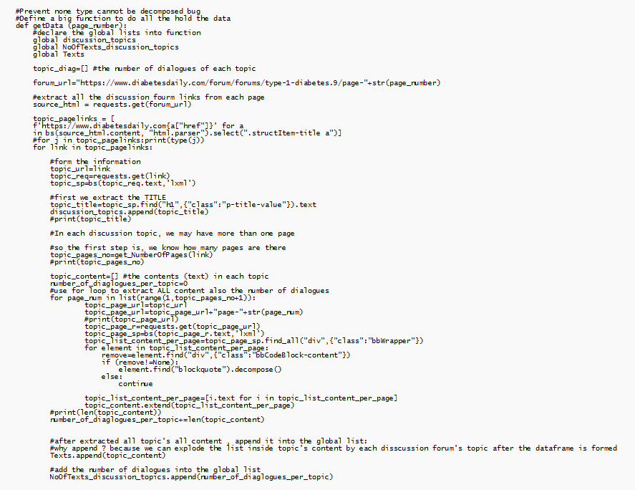

Slide 11
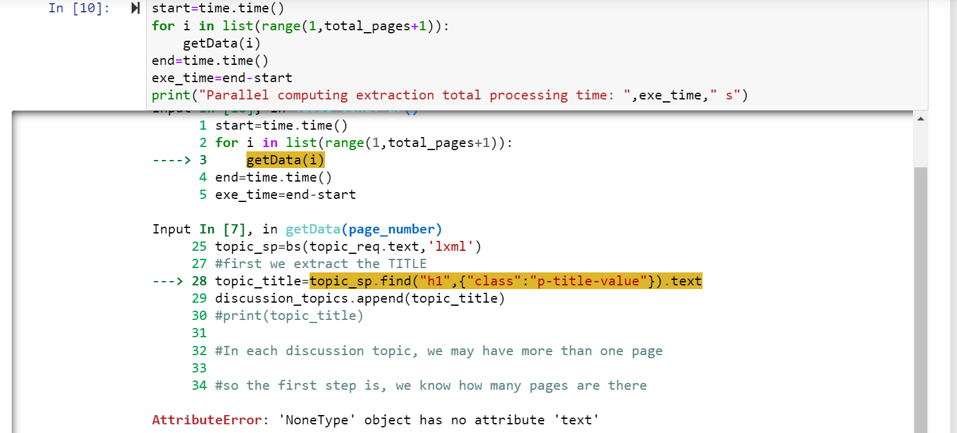
Extraction method
4. Information exrtraction (Normal Computing)
(Need self-checking
As decompose texts error is easily occurred in long-time extraction)

Slide 12
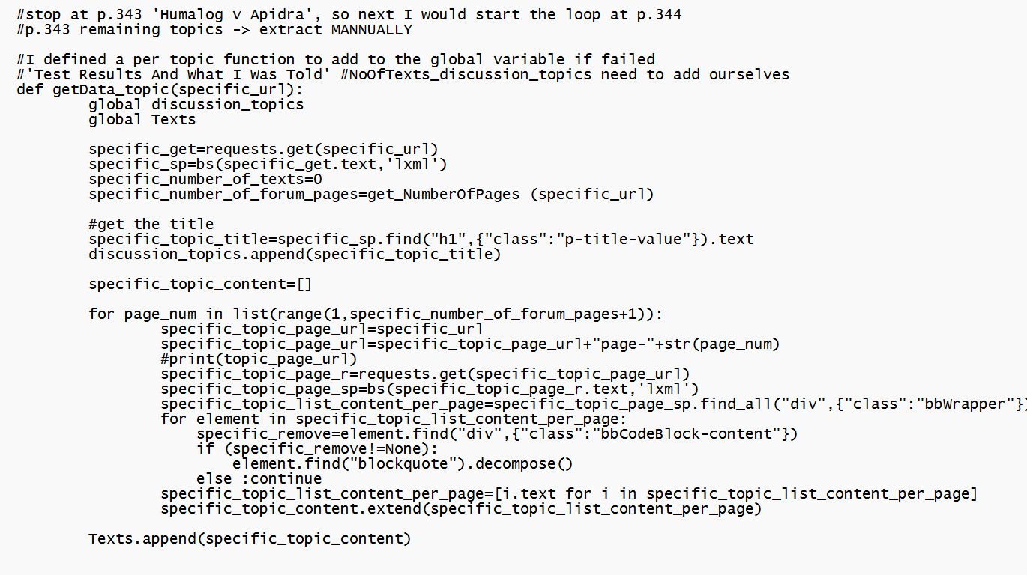
Extraction method
When decompose error, small function is needed .
-> adding the disscussion topics by its url

Slide 13
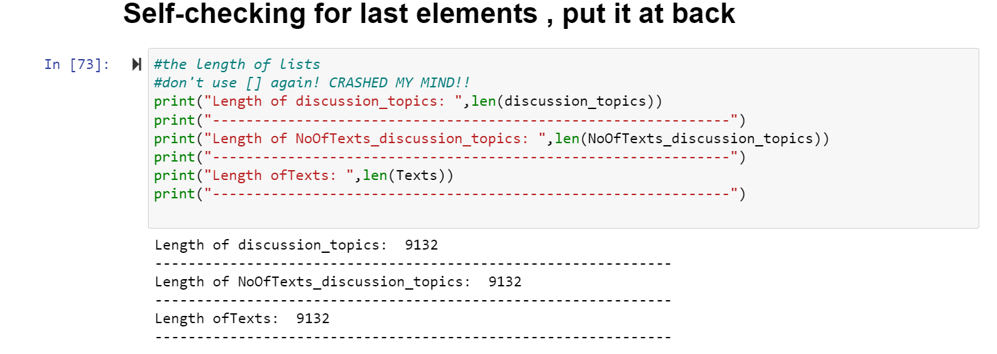
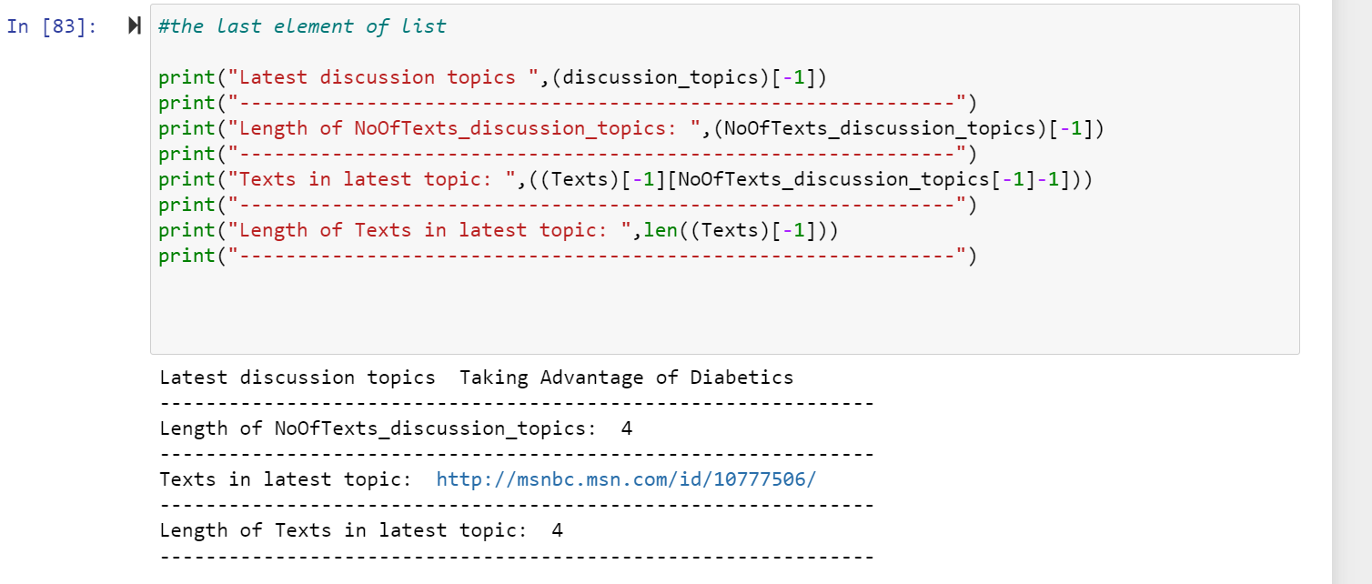
Extraction method
Self- checking code for checking process go wrong
correct order is important for us in analysis.

Slide 14
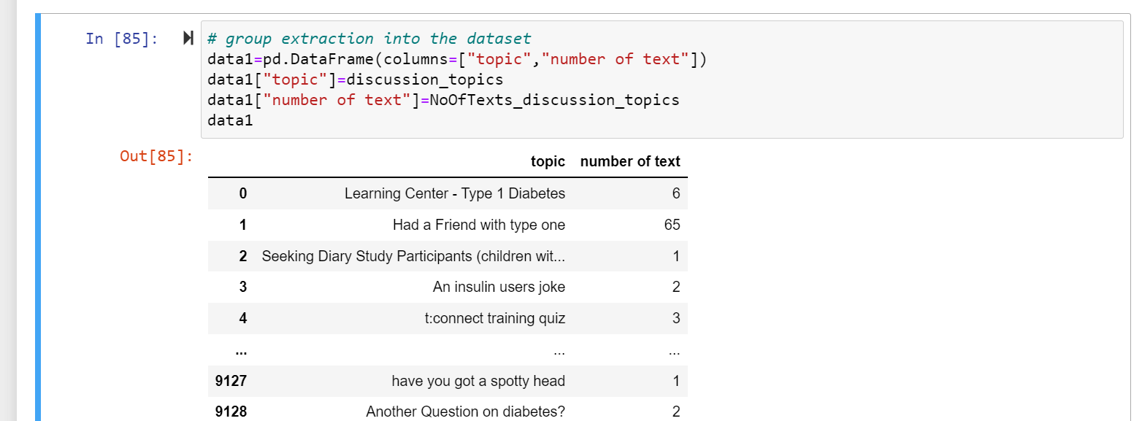
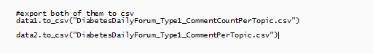
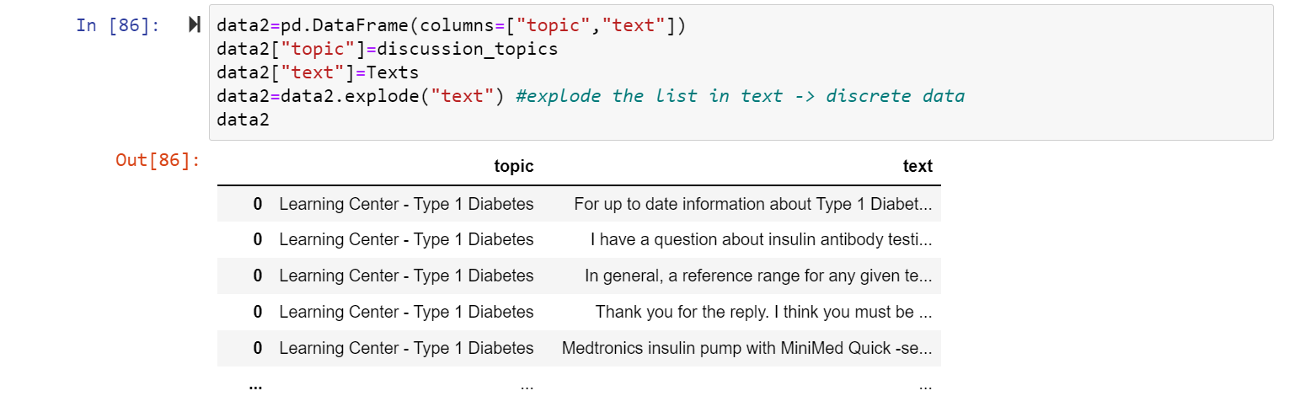
Extraction method
5. Add the result of lists to pd.DataFrame

Slide 15
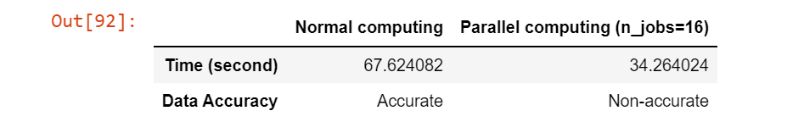
Extraction method
Why no parallel computing?
It’s fast
But the 3 lists have dependencies -> the order is SHUFFLED among lists ->not good for analysis
Comparison
3 pages extraction comparison

Slide 16
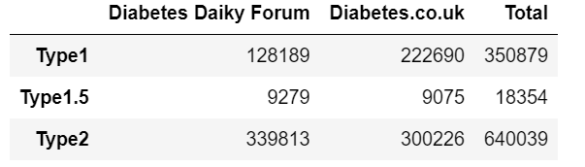
Number of comments extracted
Too few samples in type 1.5 , it is ignored.

Slide 17
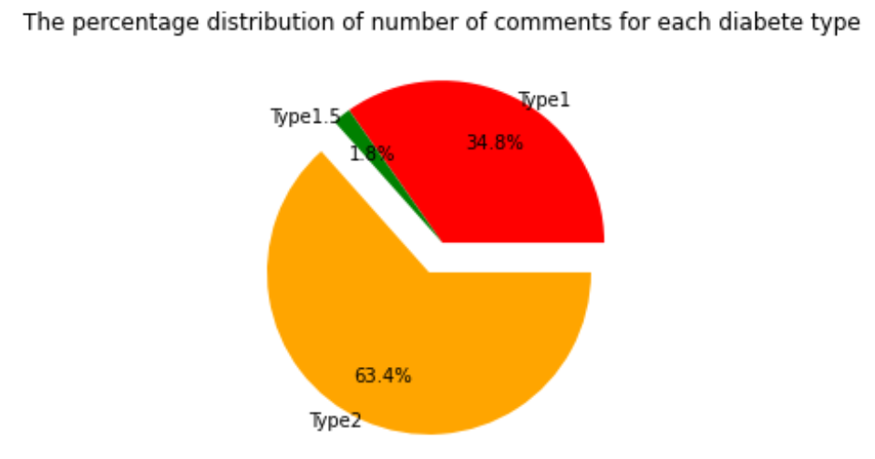
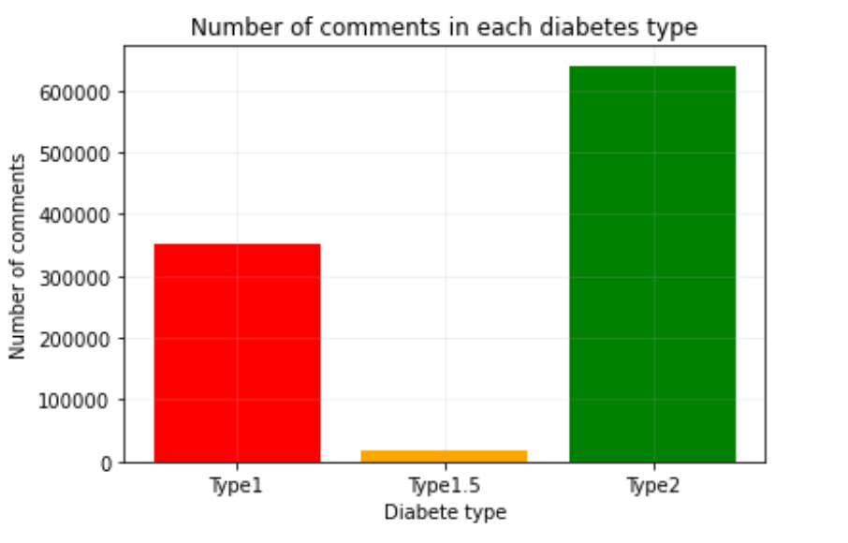
Data visuallization

Slide 18
02
Data processing

Slide 19
Spark vs Hadoop
Spark
Hadoop
APIs available (PySpark/ Scala Spark)
User-friendly
In-Memory Computing
Requires a lot of memory to run
Not designed for multiple users
MapReduce (Java/Python)
Difficult to use
Reads and writes from disk
Requires less resources

Slide 20
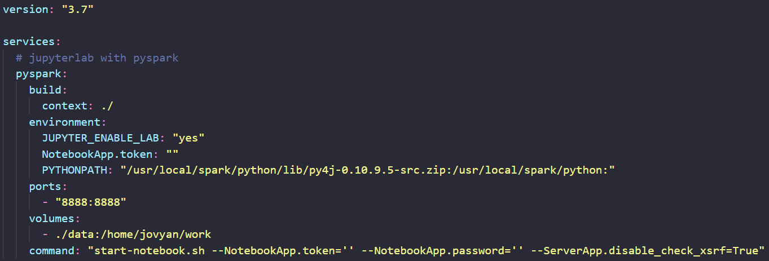
Spark Environment Setup
Use Docker container, docker-compose for configuration
Access via localhost/vscode dev container
Jupyter Notebook

Slide 21
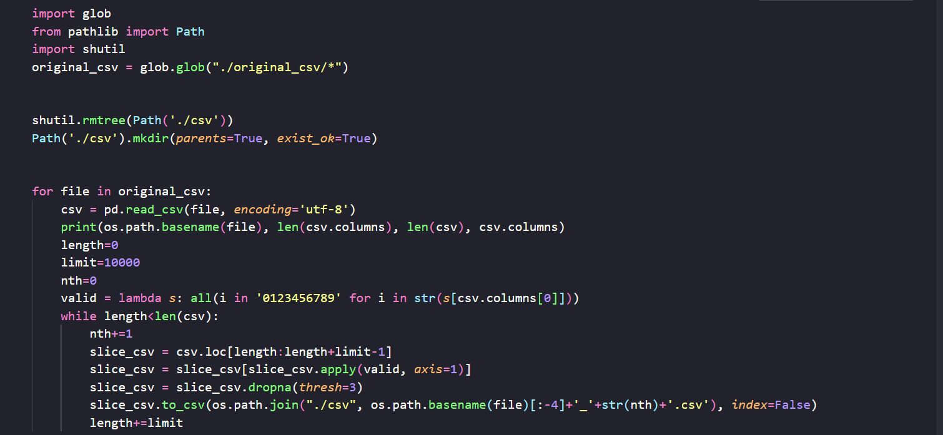
Implementation and result

Slide 22
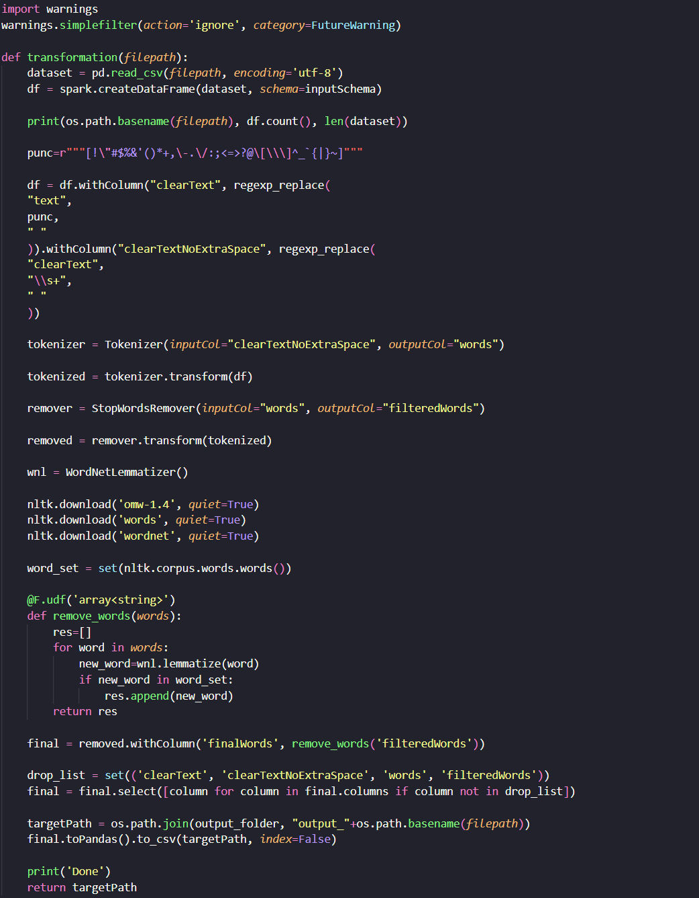
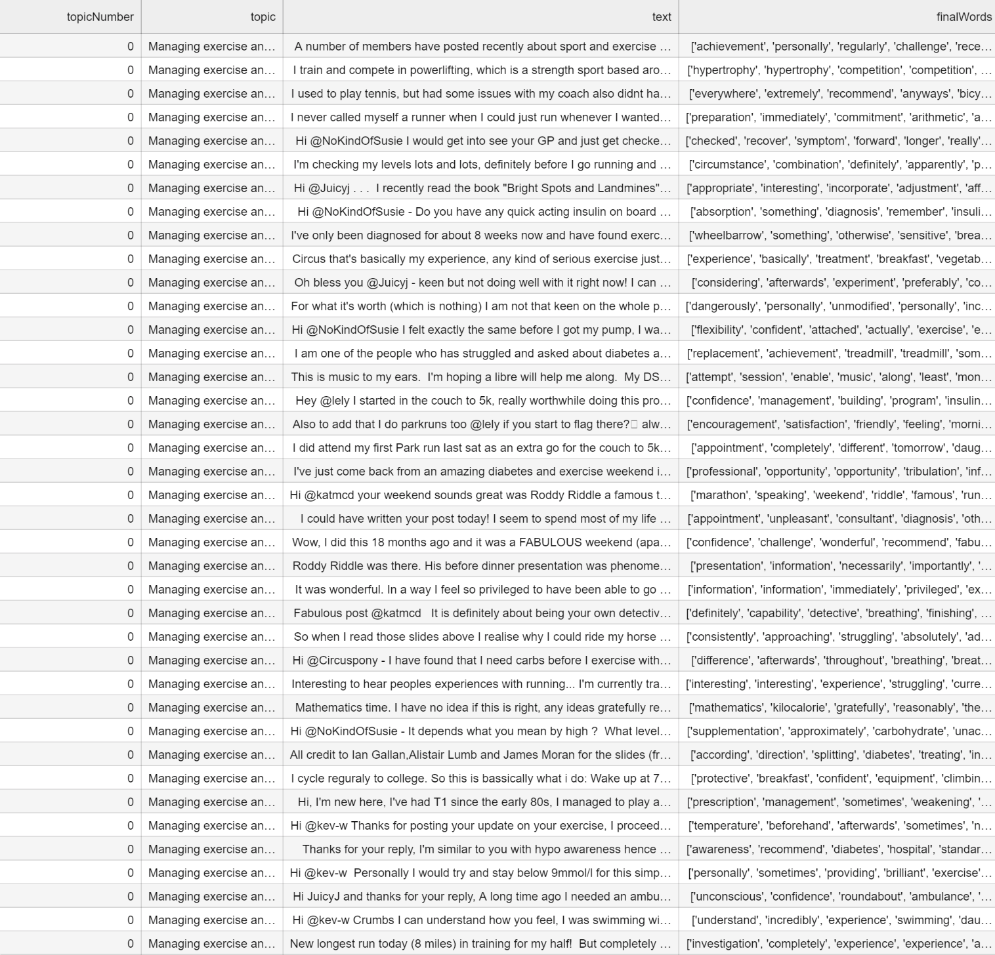
Implementation and result

Slide 23
03
Methods & Results

Slide 24
Analysis methods
Sentiment analysis
TFIDF
Word cloud

Slide 25
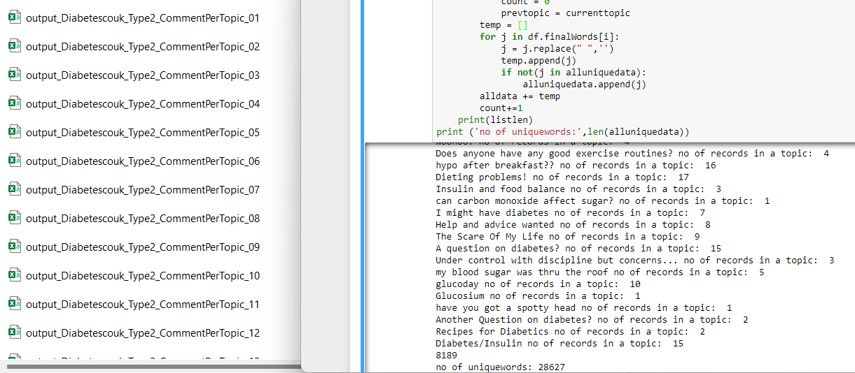
TFIDF - Implementation
Step 1: Separate and combine the information
Aims: Obtaining unique words, group tokenized words of comments by topic
Number of comment records:
Type 1: 130,000 Type 2: 600,000
Number of unique words:
Type 1: 28627 Type 2: 31327

Slide 26
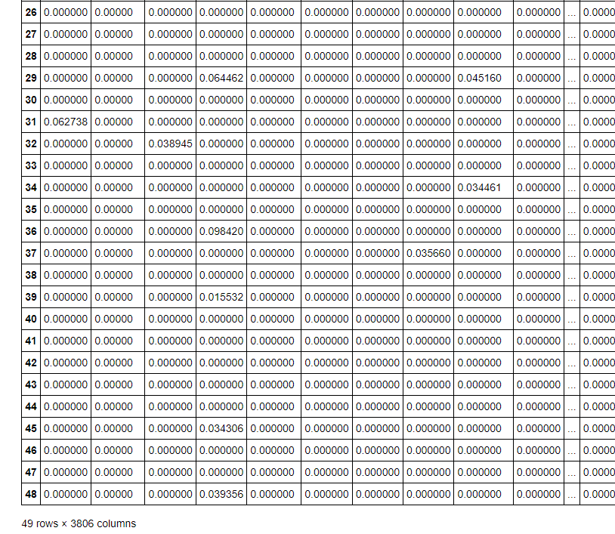
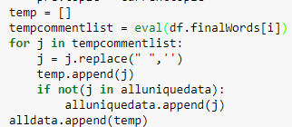
TFIDF - Implementation
Step 2
Reduce the term frequency that seldom appears
Filter out those terms from topic documents
Step 3
Convert tokens back to a list for each topic

Slide 27
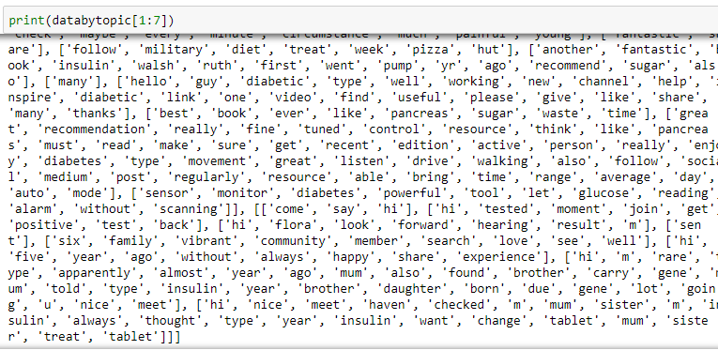
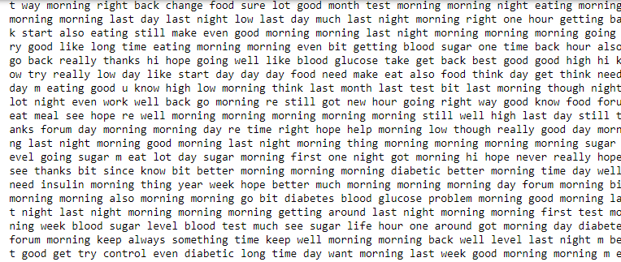
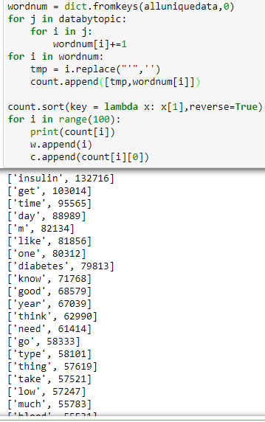
TFIDF - Implementation
Step 4:
- count term frequency,
- sort using Dict.Key

Slide 28
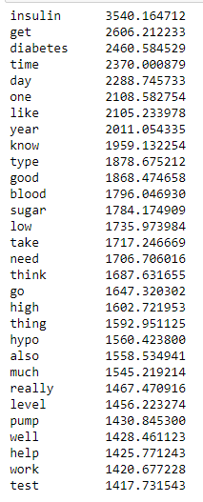
TFIDF - Vectorizer
Step 5:
- Vectorizing, comparing the relationships and sum up all the data.

Slide 29
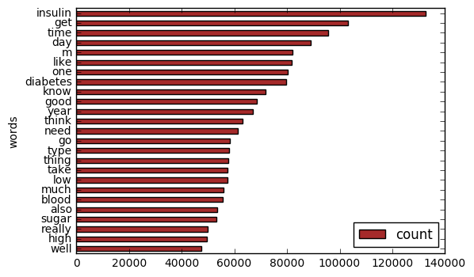
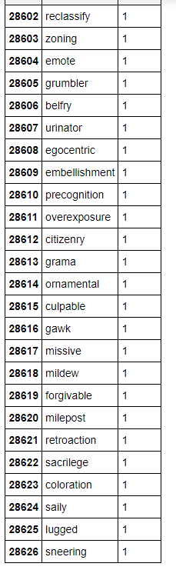
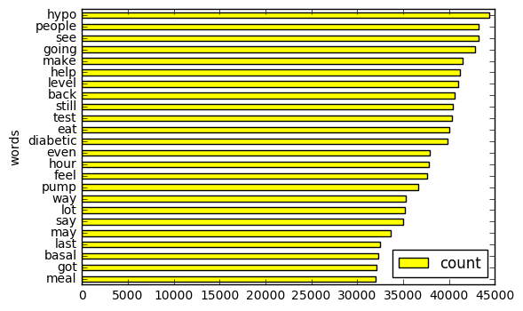
TFIDF - Type 1 Data visualization

Slide 30
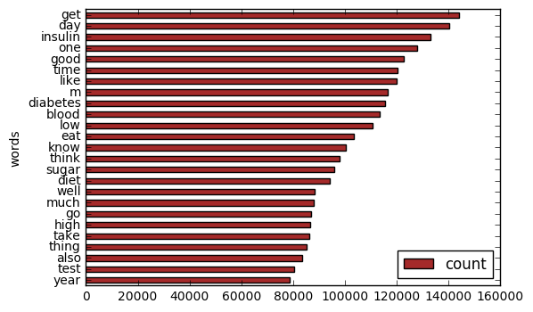
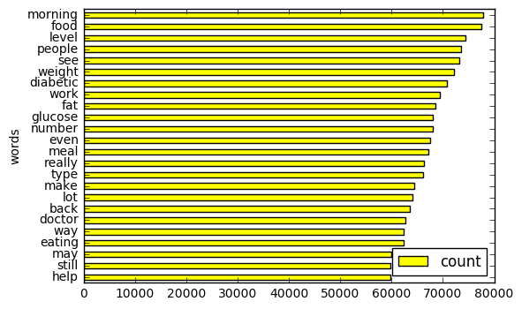
TFIDF - Type 1 & 2 Data visualization

Slide 31
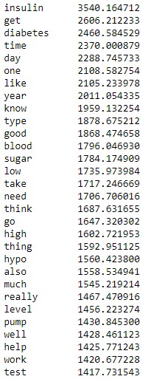
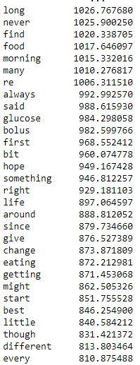
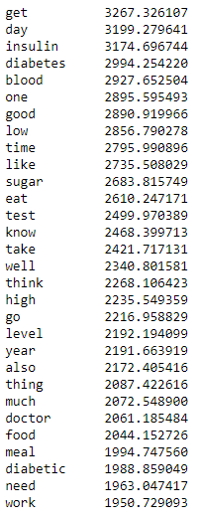
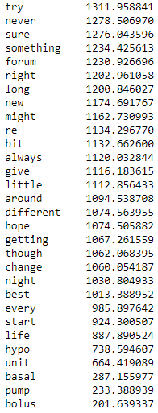
TFIDF - Comparison
Type 1
Type 2

Slide 32
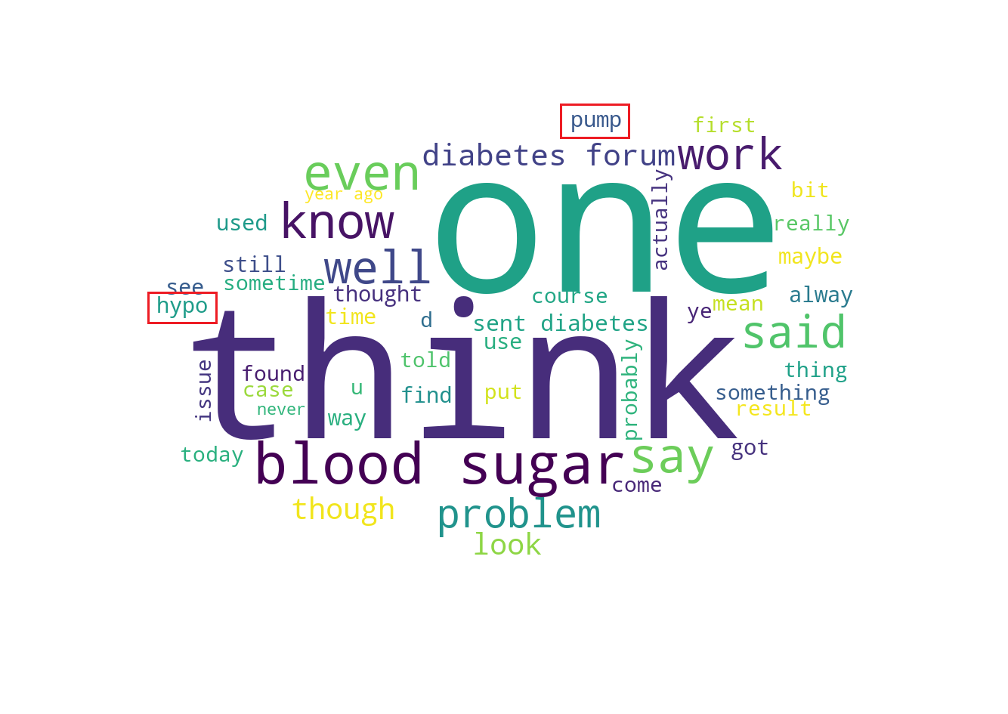
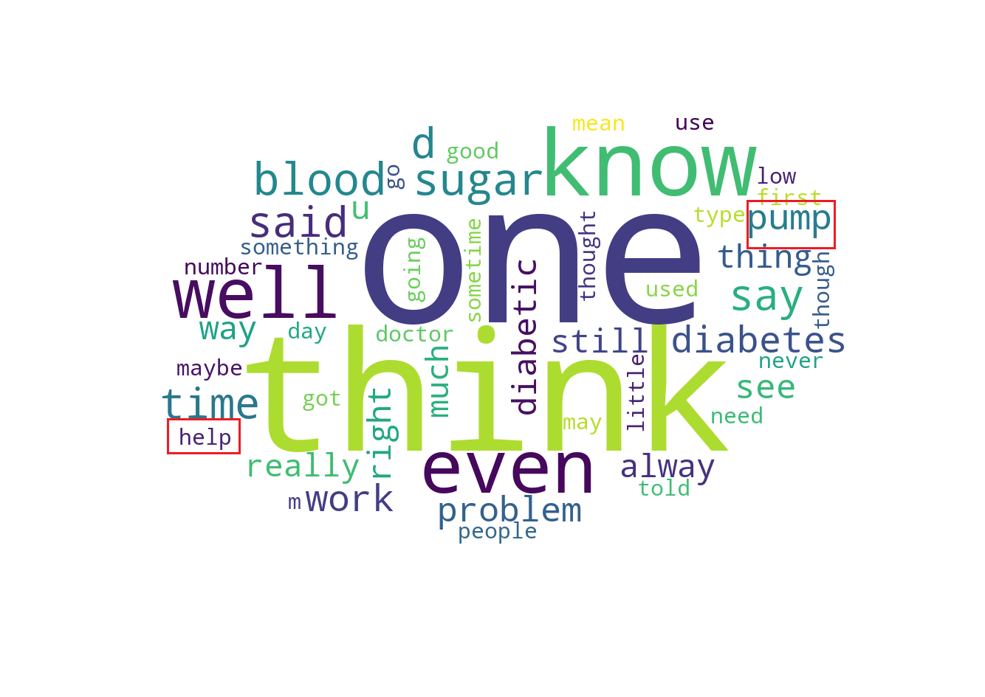
Word cloud
Type 1:
Common and frequent words are generic
Blood sugar, pump (device that release insulin) can be their concerns
Neutral sentiments, but tend to need more assistance
e.g. help

Slide 33
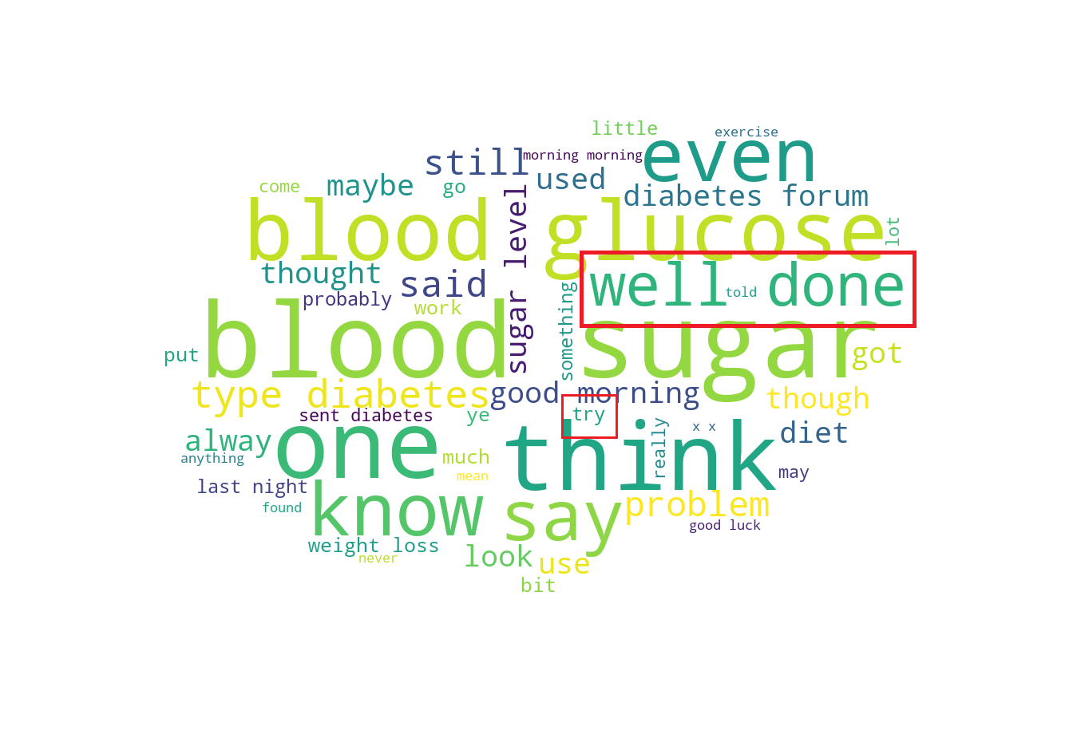
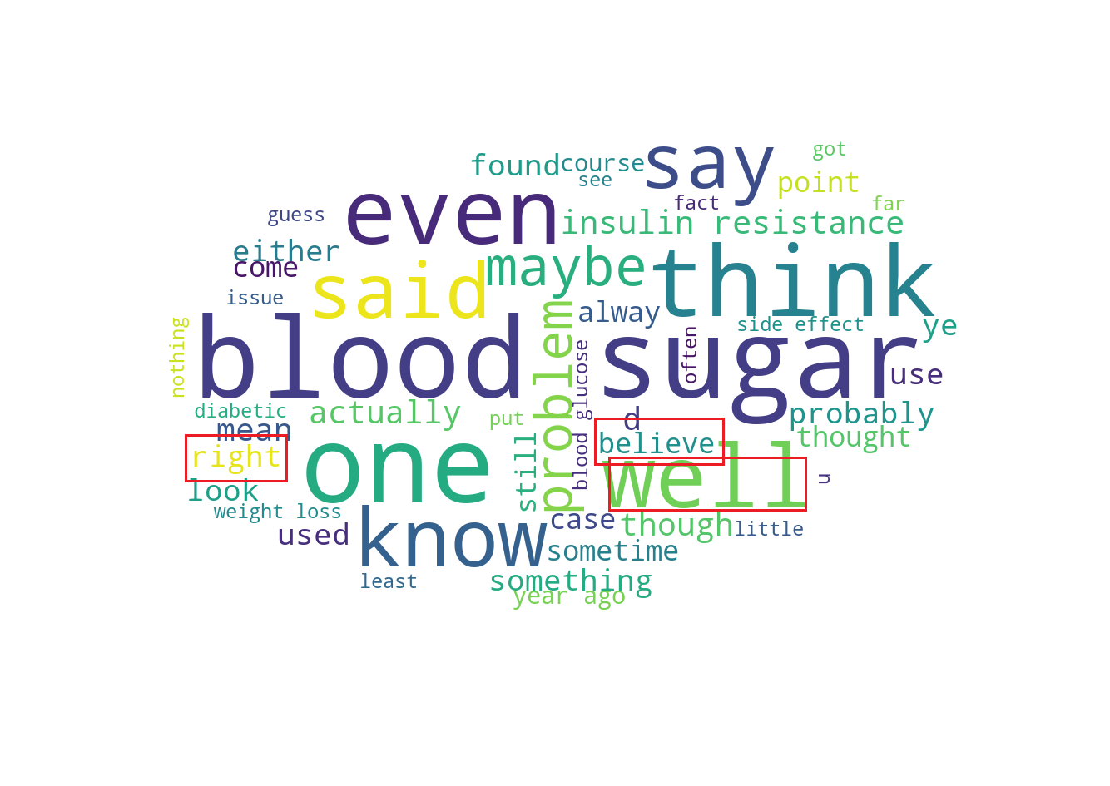
Type 2:
Common and frequent words: blood sugar, think, one
Some useful terms for investigation can be noticed
e.g. blood sugar
Relatively more positive sentiments
e.g. well done, believe, right

Slide 34
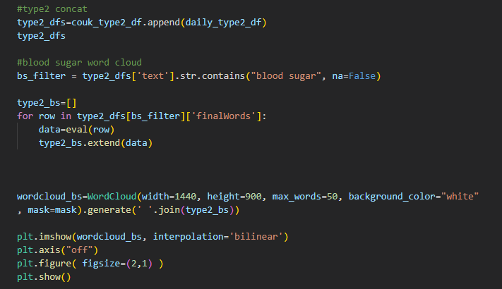
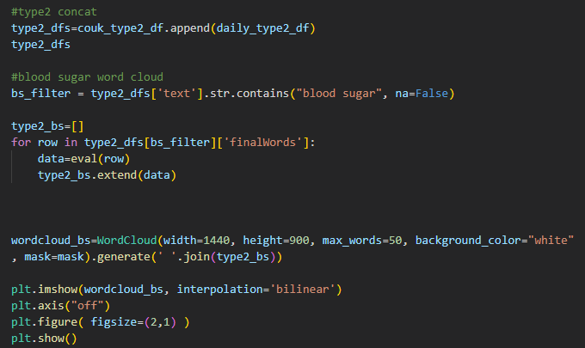
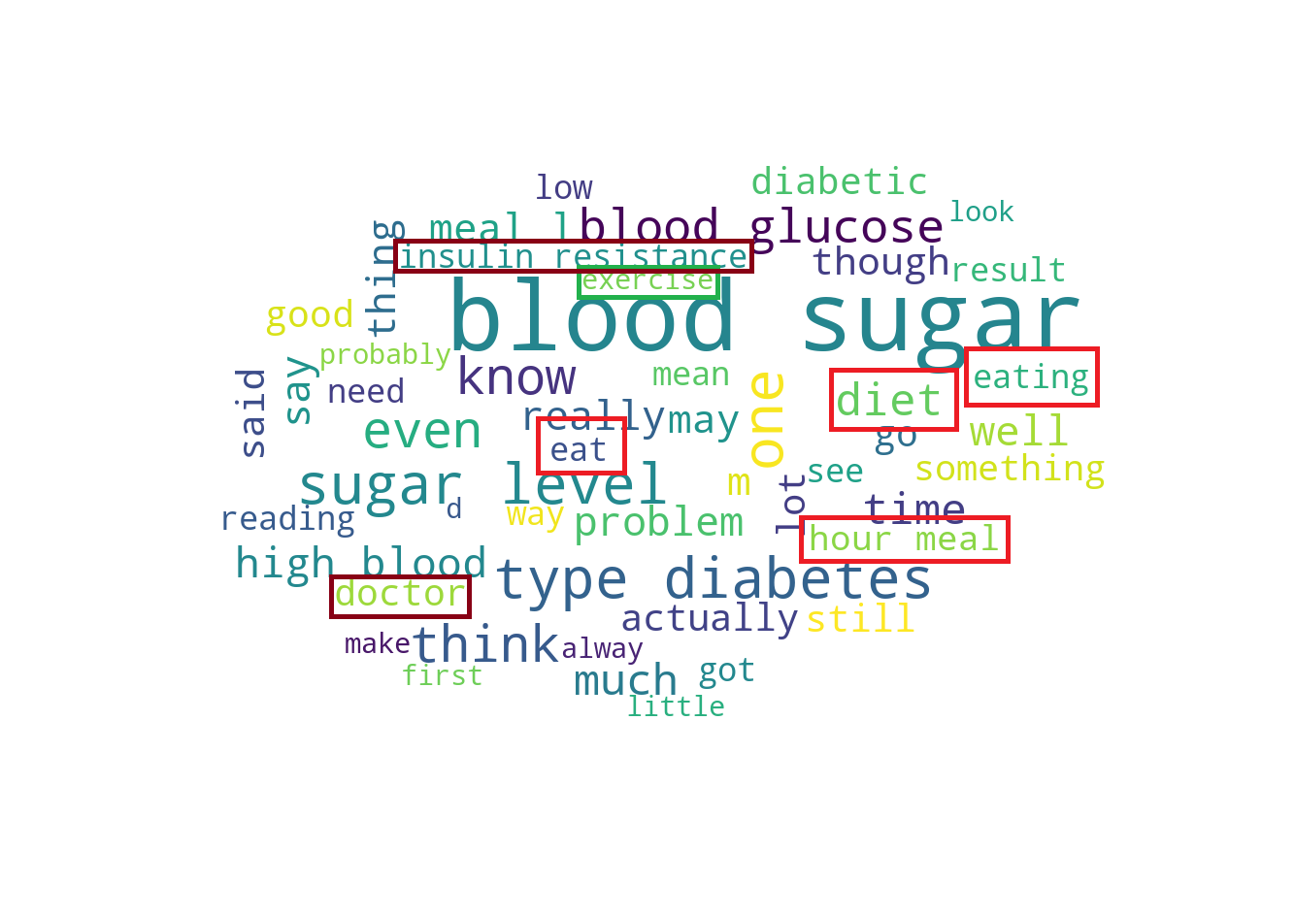
Using the term ‘blood sugar’ to filter the data
What possible factors causes blood sugar as a frequent term in type 2?
eating habits (meals, eating keywords)
insulin resistance
What they need to do?
transform their diet habit
exercise (being active makes your body more sensitive to insulin)
seek for doctor
Generate wordcloud

Slide 35
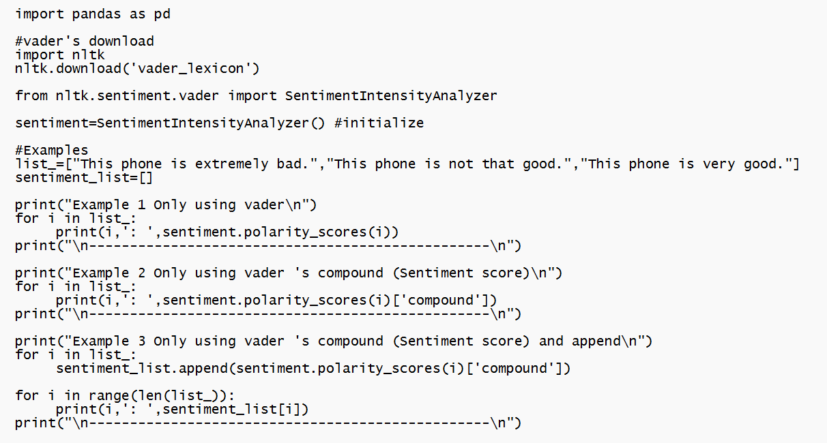
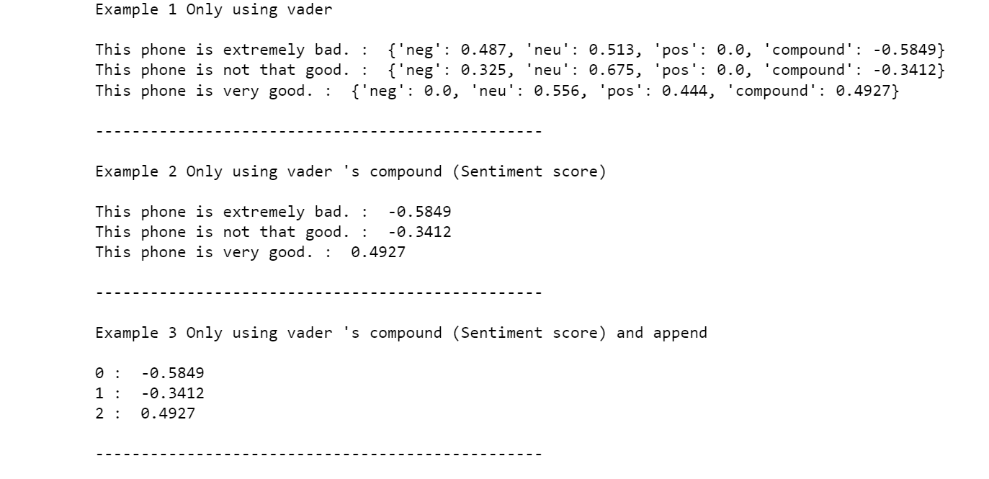
Sentiment analysis
Sentiment analysis tool: VADER (Example)
Code
Output

Slide 36
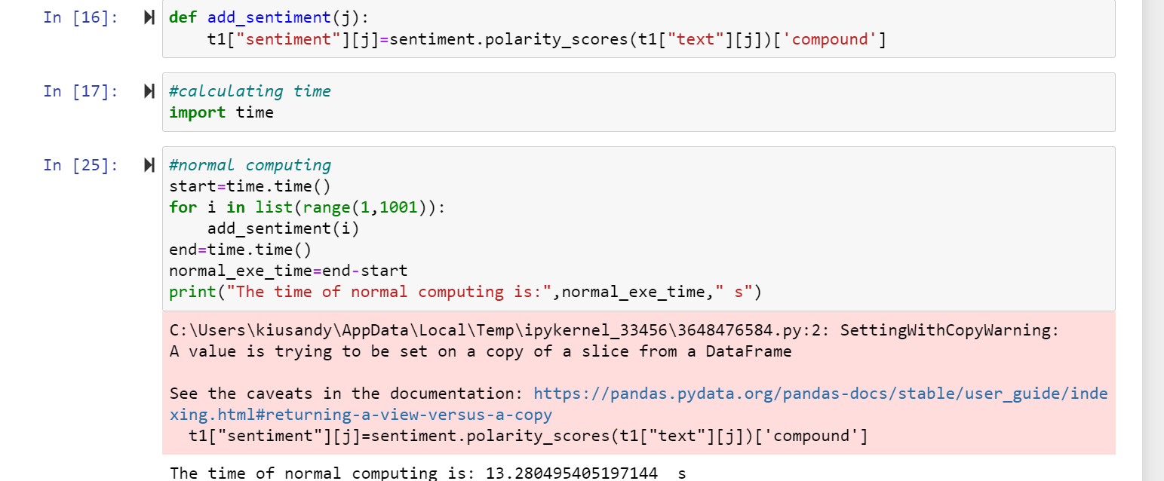
Sentiment analysis
In dataframe, column can be a list of data -> for loop
Drop na is important
Order is needed , so for loop is slow but stable

Slide 37
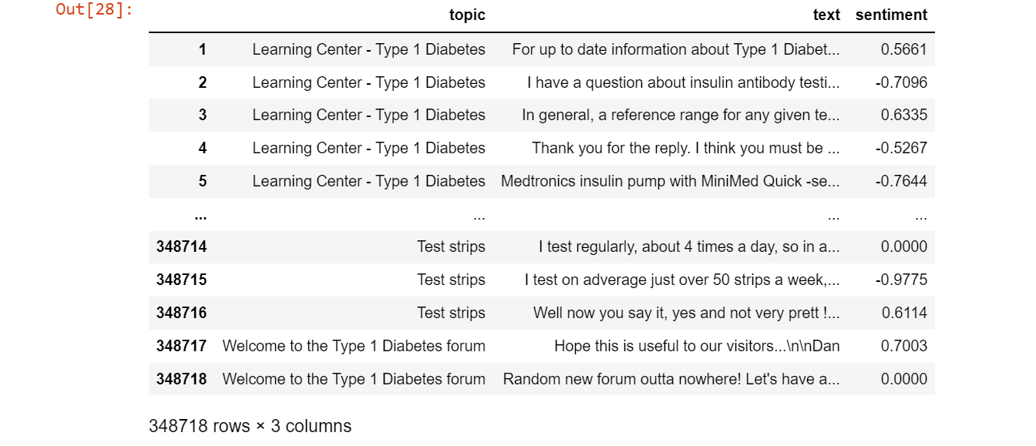
Sentiment analysis

Slide 38
Sentiment analysis
Diabetes type | Time
Type 1 | 7587.37 s
Type 2 | 9154.32 s

Slide 39
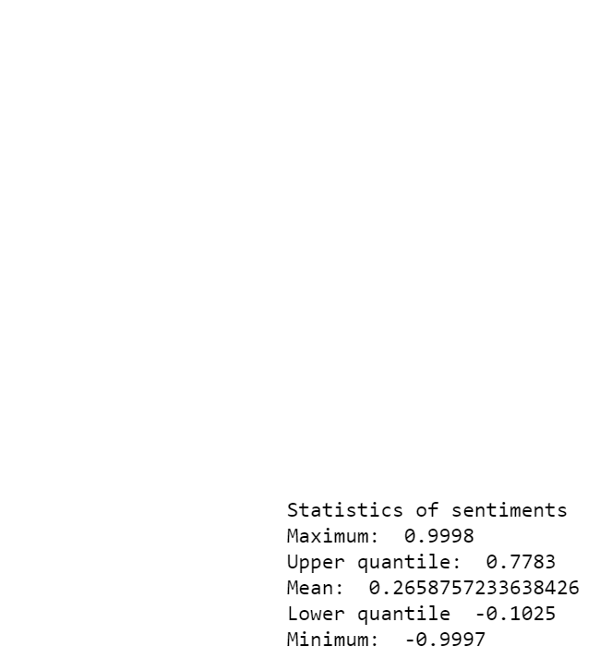
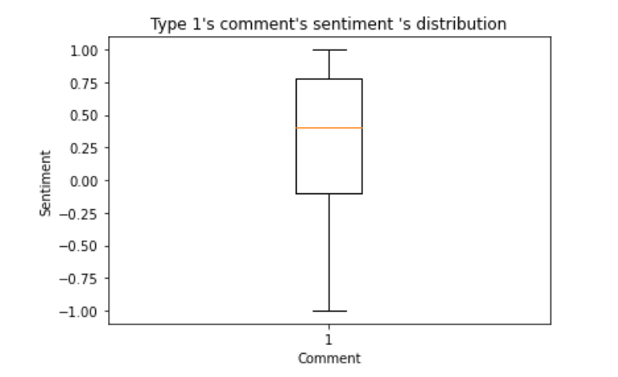
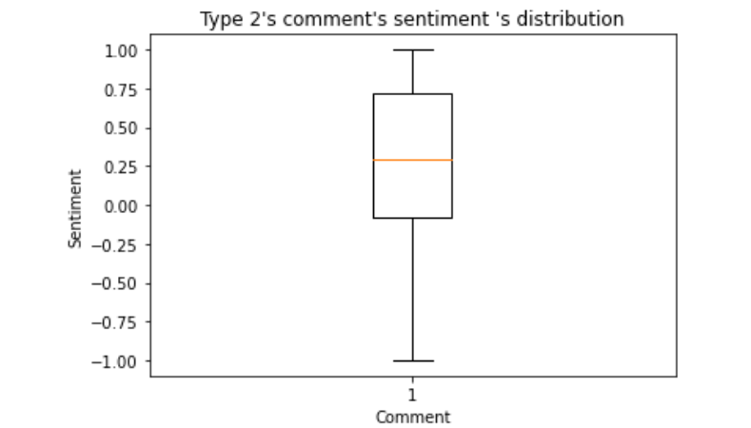

Sentiment analysis

Slide 40

Sentiment analysis result -type 1

Slide 41
Sentiment analysis result -type 1
(Obtained by comments)
Side effect of hypo : irretional anger
-> need more people’s care and understand
Type 1 patients need injection of insulin, meter -> high living cost
Many expensive holiday activities cannot be afforded
- lower life quality
->need more support from their relatives , friends, even society

Slide 42

Sentiment analysis result -type 2
Sentiment score

Slide 43
Sentiment analysis result -type 2
(Obtained by comments)
Need to lose weight quickly -> easily be stressed
The drug, Avandia (a drug for diabete type 2 adults) is still used.
Use : lowers blood sugar
Side effect : 30% higher risk of a heart attack
-> A worrying issue in their treatment.

Slide 44
04
Conclusion

Slide 45

Conclusion

Slide 46


Type1 diabetes: major sentiments are relatively neutral to negative insulin and hypo are their major concerns need support from friends and family members | Type2 diabetes: major sentiments are relatively neutral to positive weight and diet are their major concerns needs to be self-motivated

Slide 47
The End

